Slide 1
Insertions and Matching
Eric Prebys, FNAL

Slide 2
Mismatch and Emittance Dilution
In our previous discussion, we implicitly assumed that the distribution of particles in phase space followed the ellipse defined by the lattice function
Once injected, these particles will follow the path defined by the lattice ellipse, effectively increasing the emittance
Lattice ellipse
…but there’s no guarantee
What happens if this it’s not?
Injected particle distribution
Effective (increased) emittance

Slide 3
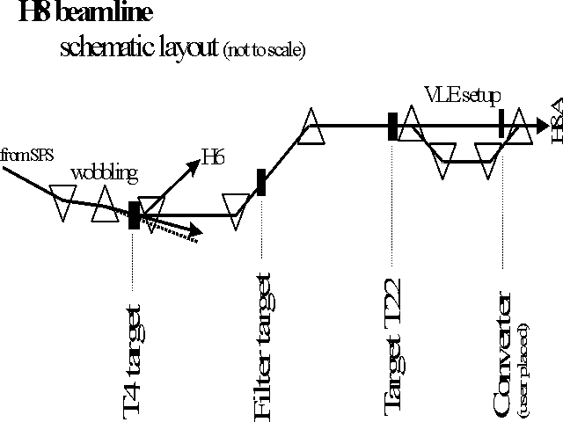
Beam Lines
In our definition and derivation of the lattice function, a closed path through a periodic system. This definition doesn’t exist for a beam line, but once we know the lattice functions at one point, we know how to propagate the lattice function down the beam line.

Slide 4
Establishing Initial Conditions
When extracting beam from a ring, the initial optics of the beam line are set by the optics at the point of extraction.
For particles from a source, the initial lattice functions can be defined by the distribution of the particles out of the source

Slide 5
Insertions
So far, we’ve talked about nice, periodic lattice, but that may not be all that useful in the real world. In particular, we generally want
Locations for injection of extraction.
“Straight” sections for RF, instrumentation, etc
Low beta points for collisions
Since we generally think of these as taking the place of things in our lattice, we call them “insertions”
FODO
FODO
FODO
Insertion
FODO
FODO
FODO
Match lattice functions

Slide 6
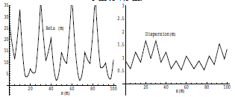
Mismatch and Beta Beating
Simply modifying a section of the lattice without matching will result in a distortion of the lattice functions around the ring (sometimes called “beta” beating)
Here’s an example of increasing the drift space in one FODO cell from 5 to 7.5 m

Slide 7
Collins Insertion
A Collins Insertion is a way of using two quads to put a straight section into a FODO lattice
Where s₂ is the usable straight region

Slide 8
Require that the lattice functions at both ends of the insertion match the regular lattice functions at those point
Where μ_{I} is a free parameter
After a bit of algebra
Maximize s₂ with μ_{I}=π/2, α max (which is why we locate it L/2 from quad)
Works in both planes if α_{x}=-α_{y} (true for simple FODO)

Slide 9
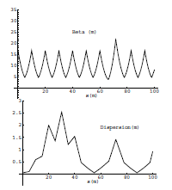
Dispersion Suppression
The problem with the Collins insertion is that it does not match dispersion, so just sticking it in the lattice will lead to distortions in the dispersion
This is typically dealt with by suppressing the dispersion entirely in the region of the insertion.
Collins Insertion

Slide 10
Dispersion Suppression (cont’d)
On common technique is called the “missing magnet” scheme, in which the FODO cells on either side of the straight section are operated with two different bending dipoles and a half-strength quad
Recall that the dispersion matrix for a FODO half cell is (lecture 6)
Straight section
Mirror image

Slide 11
So we solve for
Where D_{m} and D’_{m} are the dispersion functions at the end of a normal cell (for a simple lattice, D’_{m}=0)
We get the surprisingly simple result
Note that if μ=60°
So the cell next to the insertion is normal, and the next one has no magnets, hence the name “missing magnet”.

Slide 12
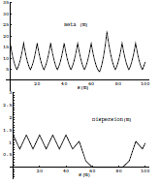
Combining Insertions
Because the Collins Insertion has no bend magnets, it cannot generate dispersion if there is none there to begin with, so if we put a Collins Insertion inside of a dispersion suppressor, we match both dispersion and the lattice functions.

Slide 13
Focusing Triplet
In experimental applications, we will often want to focus beam down to a waist (minimum β) in both planes. In general, we can accomplish this with a triplet of quadrupoles (you’ll learn more about this in the computer lab).
Such triplets are a workhorse in beam lines, and you’ll see them wherever you want to focus beam down to a point.
The solution, starting with a arbitrary lattice functions, is not trivial and in general these problems are solved numerically.

Slide 14
Low β Insertions
In a collider, we will want to focus the beam in both planes as small as possible.
This can be done with a symmetric pair of focusing triplets, matched to the lattice functions (dispersion suppression is assumed)
Recall that in a drift, β evolves as
Where s is measured from the location of the waist
Symmetric
FODO
FODO
FODO
FODO
triplet
triplet
FODO
FODO
FODO
FODO
Dispersion suppression
Dispersion suppression

Slide 15
Phase Advance of a Low Beta Insertion
We can calculate the phase advance of the insertion as
For L>>β*, this is about π, which guarantees that all the lattice parameters will match except dispersion (and we’ve suppressed that).
This means that each low beta insertion will increase the tune by about 1/2

Slide 16
Limits to β*
β
β distortion of off-momentum particles ➔ 1/β* (affects collimation)
s
➔ small β* means large β (aperture) at focusing triplet

Slide 17
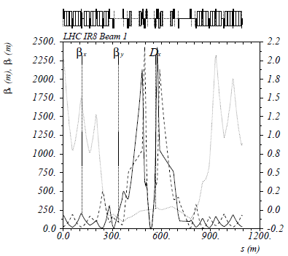
Example: The Case for New LHC Quadupoles
Proposal to increase luminosity: β*=55 cm ➔ β*=10 cm
Need bigger quads to go to smaller β*
Existing quads
70 mm aperture
200 T/m gradient
Proposed for upgrade
At least 120 mm aperture
200 T/m gradient
Field 70% higher at pole face
Beyond the limit of NbTi
Must go to Nb₃Sn

